Slide 1
Stored Procedures
Lab # 09

Slide 2
Stored Procedure
A Stored Procedure is a collection of SQL statements (queries) compiled together as a one unit. A Stored Procedure can contain multiple SQL statements such as SELECT, INSERT, UPDATE or DELETE.
they are precompiled thus reduce the overhead of compiling each time

Slide 3
Stored Procedure
Stored Procedures also help in preventing SQL Injections since parameters are used in it.
Other benefits include
Create once and call it N number of times
Reduce traffic since instead of whole query only stored procedure name is sent from front end
A Stored Procedure can be easily modified at a given point of time without modifying any code in the Application.

Slide 4
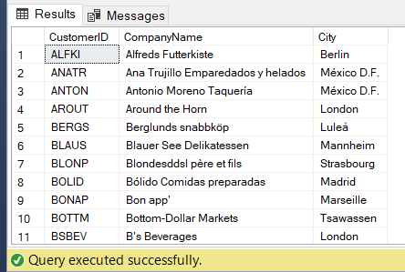
Creating a Stored Procedure
Below figure displays the syntax for creating a stored procedure. As you can see below to create a stored procedure CREATE keyword is used.
EXEC single_sp;
CREATE PROCEDURE single_sp
-- add params
AS
BEGIN
-- insert query
SELECT CustomerID, CompanyName, City
FROM Customers
END;

Slide 5
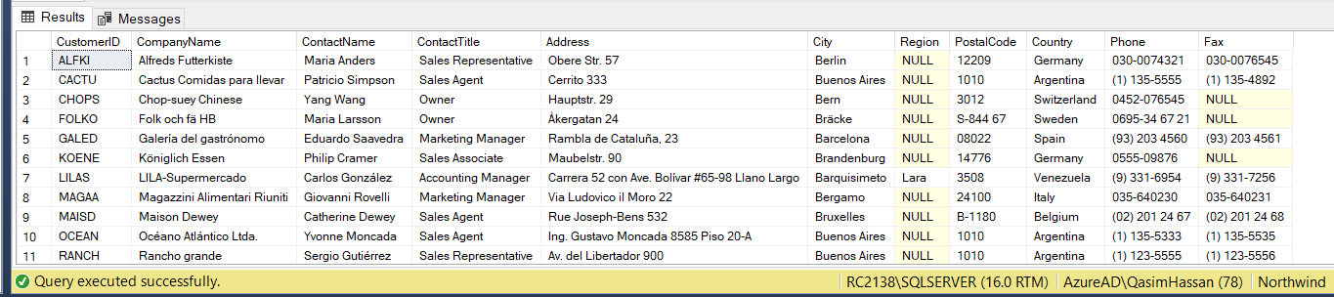
Alter Stored Procedure
ALTER PROCEDURE single_sp
-- add params
AS
BEGIN
-- insert query
SELECT *
FROM Customers
WHERE City LIKE 'b%'
END;
EXEC single_sp;

Slide 6

Drop or Delete a Stored Procedure
DROP PROCEDURE single_sp

Slide 7
Declaring Parameters
Declaring a parameter requires two to four of these pieces of information:
The name
The data type
The default value
The direction

Slide 8
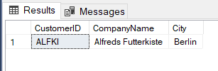
EXAMPLE
-- varibale in stored procedure
CREATE PROCEDURE variable_sp
@city_name VARCHAR(20)
AS
BEGIN
SELECT CustomerID, CompanyName, City
FROM Customers
WHERE City = @city_name
END;
EXEC variable_sp Berlin;

Slide 9
Supplying Default Values
To make a parameter optional, you have to supply a default value.
This looks just like you’re initializing a variable: you just add an = together with the value you want to use for a default after the data type, but before the comma.
Once you’ve done this, the users of your sproc can decide to supply no value for that parameter, or they can provide their own values

Slide 10
Supplying Default Values
-- altering stored procedure
ALTER PROCEDURE variable_sp
@city_name VARCHAR(20) = 'Berlin'
AS
BEGIN
SELECT CustomerID, CompanyName, City
FROM Customers
WHERE City = @city_name
END;

Slide 11
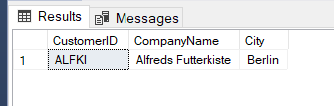
Supplying Default Values
Given your new default, you can now run the procedure without a parameter
Supplying the value to the required parameter
EXEC variable_sp;
EXEC variable_sp London;

Slide 12
A Stored Procedure:
accepts parameters
can NOT be used as building block in a larger query
can contain several statements, loops, IF ELSE, etc.
can perform modifications to one or several tables
A View:
does NOT accept parameters
can be used as building block in a larger query
can contain only one single SELECT query
can NOT perform modifications to any table

Slide 13

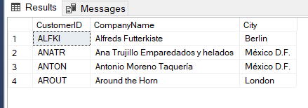
Example:
-- altering stored procedure
ALTER PROCEDURE variable_sp
@city_name VARCHAR(20) = 'Berlin'
AS
BEGIN
IF @city_name != 'Berlin'
SELECT CustomerID, CompanyName, City
FROM Customers
WHERE CompanyName LIKE 'A%'
ELSE
SELECT CustomerID, CompanyName, City
FROM Customers
WHERE City = @city_name
END;
EXEC variable_sp Berlin;
EXEC variable_sp London;

Slide 14
References
BOOK : Microsoft® SQL Server ® 2012 Programming by Paul Atkinson
& Robert Vieira - Chapter 12 - Stored Procedure

Slide 15
TASK
Write a simple stored procedure that returns the desired Customer record from the Northwind database given a parameter of the CustomerID.
Write a stored procedure that accepts a Territory ID, Territory Description, and Region ID and inserts them as new row in the Territories table in Northwind.
Write 3 stored procedures :
1st to Insert Employee detail
2nd to Update Employee detail &
3rd to Delete Employee
(You can create a new, Employee, table or use the one that already exists in Northwind DB)

Slide 16
HINT
create PROCEDURE MasterInsertSelect
(
@id INTEGER,
@first_name VARCHAR(10),
@last_name VARCHAR(10),
@salary DECIMAL(10,2),
@city VARCHAR(20),
@StatementType nvarchar(20) = ''
)
AS
BEGIN
IF @StatementType = 'Insert'
BEGIN
insert into employee (id,first_name,last_name,salary,city) values( @id, @first_name, @last_name, @salary, @city)
END
IF @StatementType = 'Select'
BEGIN
select * from employee
END
EXECUTION:exec MasterInsertUpdateDelet 23,amna,ali,3.0,we ,"insert"

Slide 17
TASK
Create a stored procedure DISPLAY without parameters. The procedure must display empno, ename and title of all the employees of DEPTNO = 101.
Create a stored procedure DISPLAY2 with parameters. It must take DEPTNO as an input and must return the DNAME and TOTAL SALARY of the input department number.
Create a stored procedure DISPLAY3 with parameters. It must take DEPTNO as an input and must return the DNAME, SMALLEST and HIGHEST SALARIES of the input department number. DISPLAY3 must also display empno,ename,total salary (sal+comm) of all the employees of the input department number.

